Slide 1
Skills Bootcamp Classroom Rules
Be on time: Just like in a physical classroom, it's important to be punctual for your online class. Log in to the virtual classroom a few minutes before the class starts.
Turn Cameras on: In order to maximise your learning studies show that being able to see your peers and your tutor being able to see you can increase motivations and retention, therefore we ask to keep your cameras on.
Attend all classes: In order to be successful in your bootcamp studies you need to attend all live sessions, therefore you should prioritise and make time for these sessions.
Avoid distractions: Turn off your phone notifications, close any other unnecessary tabs, and focus solely on the class.
Participate actively: It's important to be an active participant in the class. Ask questions, answer questions, and participate in discussions.
Use proper language and tone: Use respectful language and tone when communicating with your classmates and instructor. Avoid using slang or inappropriate language.
Respect others' opinions: Be respectful of others' opinions, even if they differ from your own. Avoid making negative comments or attacking others.
Follow the instructor's guidelines: Follow the instructor's guidelines, such as submitting assignments on time.
Be polite: Be polite and respectful to everyone in the class, including the instructor, classmates, and guest speakers.
Dress appropriately: Even though you are not in a physical classroom, it's important to dress appropriately. Dress as if you were going to a face-to-face class.
Use appropriate technology: Ensure that you have the necessary equipment, such as a reliable internet connection, a microphone, and a webcam, and that they are in good working condition.

Slide 2
Software Developer Bootcamp
Unit 1 – Introduction to Software Development
Week 3C

Slide 3
Learning Outcomes
Following this session, you should be able to:
Data structures and their importance and showcase the data structures used in the demonstration program.
Basic algorithms that can be used in the software and the rationale for choosing certain algorithms over others.
Choice of platform based on different factors and the impact of evolving industry needs on platform and algorithm choices.
Notes:
Today, we're going to delve into some of the most critical aspects of software development: data structures, algorithms, and platform choices.

Slide 4
Data Structures and Their Importance
Notes:
We'll start by discussing data structures, move on to algorithms, and finally discuss how to choose the right platform for your software project.

Slide 5

What is a Data Structure?
A data structure is a way of organizing data in a computer so that it can be used efficiently.
Data structures are used to store, organize, and manipulate data in a computer program.
Notes:
Data structures are specialised formats for organising and storing data on a computer. They include arrays, linked lists, stacks, and more. Understanding data structures is crucial for efficient programming.

Slide 6

Types of Data Structures
There are many different types of data structures, including arrays, linked lists, trees, and graphs.
Each type of data structure has its own advantages and disadvantages, and is used for different purposes.
Notes:
Data structures come in various types, such as arrays, linked lists, stacks, queues, trees, and hash tables, each with its own set of advantages and use-cases.

Slide 7

Data Structures in Action
Data structures are used to solve complex problems in computer science.
For example, a linked list can be used to store a list of items in a specific order, and a tree can be used to store data in a hierarchical structure.
Notes:
Data structures are vital for the efficient storage and retrieval of data, which becomes increasingly important as your software scales. Data structures find applications in various domains, such as database management, computer graphics, artificial intelligence, and network routing, to name a few.

Slide 8

Data Structures
Arrays
Linked Lists
Stacks
Queues
Trees
Dictionary

Slide 9
Data Structures
Arrays
- Fixed-size
- Contiguous memory allocation
- Efficient for indexed data access
- Poor at insertions and deletions
Python
# Using Python list as an array
grades = [90, 85, 77, 92]
print("First student's grade:", grades[0])

Slide 10
Data Structures
Linked Lists
- Dynamic size
- Non-contiguous memory allocation
- Efficient at insertions and deletions
- Slower data access compared to arrays
Python
# Using Python's collections.deque as a linked list
from collections import deque
playlist = deque(["Song1", "Song2", "Song3"])

Slide 11
Data Structures
Stacks
- Last-In, First-Out (LIFO) structure
- Efficient for undo mechanisms, backtracking algorithms
- Limited to top element access
Python
# Using Python list as a stack
stack = []
stack.append("Undo1")
stack.append("Undo2")
last_undo = stack.pop()
print("Last undo:", last_undo)

Slide 12
Data Structures
Queues
- First-In, First-Out (FIFO) structure
- Useful in scheduling tasks, breadth-first search algorithms
- Limited to front and rear element access
Python
# Using Python's queue.Queue as a queue
from queue import Queue
q = Queue()
q.put("Print1")
q.put("Print2")
first_print = q.get()
print("First print job:", first_print)

Slide 13
Data Structures
Dictionary Data Structure
- A dictionary is an unordered collection of key-value pairs, where each key must be unique.
- Unordered: No inherent order of elements.
- Key-Value Pairs: Stores data as key-value pairs.
- Unique Keys: Each key must be unique.
- Dynamic Sizing: Size can change dynamically.
- Indexed by Keys: Accessed via keys, not integer indices.
Python
- Defined using curly braces `{}` with key-value pairs separated by colons.
my_dict = {'key1': 'value1', 'key2': 'value2'}

Slide 14

The Importance of Data Structures
Data structures are essential for making programs efficient and powerful.
By using the right data structure for the job, a program can be made faster, more efficient, and more powerful.

Slide 15

Data Structures and Algorithms
Data structures and algorithms are closely related.
Algorithms are used to manipulate data stored in data structures, and data structures are used to store the data used by algorithms.

Slide 16

Data Structures and Performance
The performance of a program can be greatly improved by using the right data structure for the job.
By using the most efficient data structure for a given task, a program can be made faster and more efficient.

Slide 17

Data Structures and Memory
Data structures can also be used to save memory.
By using the most efficient data structure for a given task, a program can use less memory and run faster.
Notes:
Data structures are essential for making programs efficient and powerful.
Using the right data structure for the job can make a program faster, more efficient, and more powerful.

Slide 18
Basic Algorithms in Software

Slide 19

What is an Algorithm?
An algorithm is a set of instructions that are used to solve a problem or accomplish a task.
Algorithms are used in software development to create efficient and effective solutions to problems.
Algorithms can be represented in a variety of ways, such as flowcharts, pseudocode, or diagrams.
Notes:
Algorithms are sets of instructions designed to perform specific tasks. They can be sorting, search, or even complex machine learning algorithms.

Slide 20

Types of Algorithms
There are many different types of algorithms, including sorting algorithms, search algorithms, and graph algorithms.
Sorting algorithms are used to arrange data in a certain order, such as alphabetical or numerical order.
Search algorithms are used to find specific items in a data set, such as a particular value or record.
Graph algorithms are used to traverse and analyze graphs, such as finding the shortest path between two nodes.

Slide 21
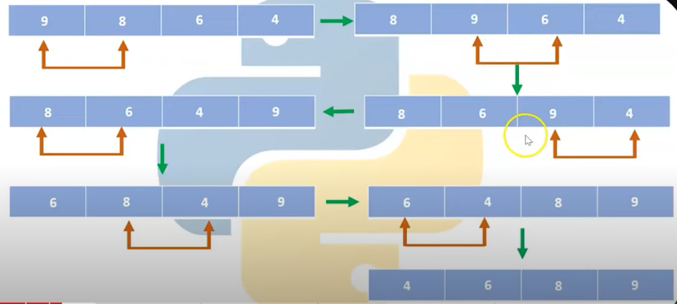
Types of Algorithms
Sorting Algorithms
- Purpose: To arrange elements in a specific order
- Examples: Quick Sort, Merge Sort, Bubble Sort
- Use Case: Sorting a list of names alphabetically
Searching Algorithms
- Purpose: To find the location of an element within a data structure
- Examples: Binary Search, Linear Search
- Use Case: Finding a book in a library system

Slide 22
Types of Algorithms
Graph Algorithms
- Purpose: To solve problems related to graphs and networks
- Examples: Dijkstra's Algorithm, Floyd-Warshall Algorithm
- Use Case: Finding the shortest path in a map
Dynamic Programming Algorithms
- Purpose: To solve problems by breaking them down into smaller subproblems
- Examples: Fibonacci sequence, Knapsack problem
- Use Case: Resource allocation in project management

Slide 23
Types of Algorithms
Divide and Conquer Algorithms
- Purpose: To break a problem into smaller parts and solve each part independently
- Examples: Quick Sort, Merge Sort
- Use Case: Multiplying large integers
Greedy Algorithms
- Purpose: To find a good enough solution by making the best choice at each step
- Examples: Kruskal's Algorithm, Huffman Coding
- Use Case: Network routing

Slide 24
Types of Algorithms
Backtracking Algorithms
- Purpose: To solve problems by trying out different solutions and undoing them if necessary
- Examples: N-Queens Problem, Sudoku Solver
- Use Case: Puzzle solving
Brute Force Algorithms
- Purpose: To solve problems by trying every possible solution
- Examples: Linear Search, Travelling Salesman Problem (naive approach)
- Use Case: Password cracking

Slide 25
Types of Algorithms
Recursive Algorithms
- Purpose: To solve problems by calling the algorithm itself as a subroutine
- Examples: Factorial calculation, Tower of Hanoi
- Use Case: File system traversal
Probabilistic and Heuristic Algorithms
- Purpose: To find approximate solutions for complex problems
- Examples: Monte Carlo methods, Genetic Algorithm
- Use Case: Optimising complex systems

Slide 26

Choosing the Right Algorithm
When choosing an algorithm for a software project, it is important to consider the complexity of the problem and the resources available.
For example, if the problem is simple and the resources are limited, a simple algorithm may be the best choice.
On the other hand, if the problem is complex and the resources are plentiful, a more complex algorithm may be necessary.

Slide 27
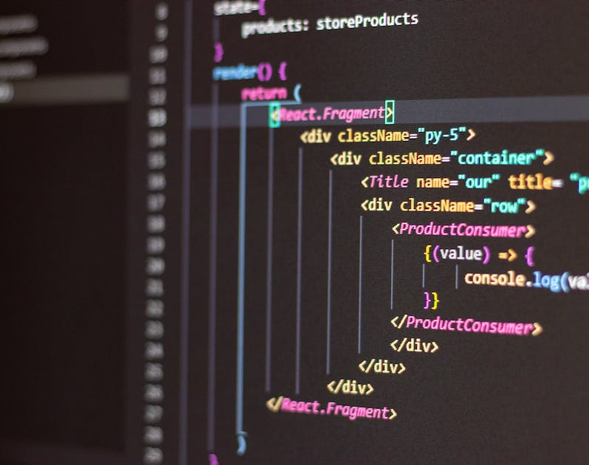
Advantages of Algorithms
Algorithms can provide many advantages to software development, such as improved efficiency, scalability, and accuracy.
Algorithms can also help to reduce the amount of time and resources needed to solve a problem.
In addition, algorithms can help to reduce the complexity of a problem, making it easier to understand and debug.
Notes:
Algorithms are the backbone of any software application. They allow us to solve problems efficiently and automate various tasks.

Slide 28

Disadvantages of Algorithms
Algorithms can also have some drawbacks, such as increased complexity and difficulty in debugging.
In addition, algorithms can be difficult to understand and can require a significant amount of time and resources to implement.
Finally, algorithms can be difficult to maintain and can become outdated over time.

Slide 29

Best Practices for Algorithms
When using algorithms in software development, it is important to follow best practices to ensure the best results.
It is important to choose the right algorithm for the problem at hand and to consider the complexity of the problem and the resources available.
In addition, it is important to test and debug algorithms to ensure they are working correctly and to make sure they are efficient and effective.
Notes:
Algorithms are an important part of software development and can provide many advantages, such as improved efficiency, scalability, and accuracy.
When choosing an algorithm for a software project, it is important to consider the complexity of the problem and the resources available.
It is also important to follow best practices when using algorithms, such as testing and debugging to ensure they are working correctly and efficiently.

Slide 30
Choice of Platform Based on Different Factors and the Impact of Evolving Industry Needs on Platform

Slide 31
What is a Platform?
Definition of a Platform
- A platform is a foundational technology or service upon which other applications, processes, or technologies are built and operated.
Types of Platforms
- Platforms can be categorised into various types, such as operating systems, cloud services, software frameworks, and hardware platforms.
Examples of Platforms
- Examples include Microsoft Windows as an operating system, AWS as a cloud service, TensorFlow as a machine learning framework, and Raspberry Pi as a hardware platform.
Notes:
Platform choices refer to the selection of operating systems, databases, and other technologies that will host and run your software.

Slide 32
Factors to Consider When Choosing a Platform
Cost
- Cost refers to the financial investment required to develop, deploy, and maintain a software solution, encompassing hardware, software, and human resources.
Scalability
- Scalability is the ability of a system to handle increased workload or expand in response to an increased demand for processing power, storage, or number of transactions.

Slide 33
Factors to Consider When Choosing a Platform
Security
- Security pertains to the measures and protocols in place to protect a system and its data from unauthorised access, tampering, or breaches.
Flexibility
- Flexibility is the ease with which a system can adapt to changes in requirements, technologies, or operational environments without requiring significant modifications.
Integration
- Integration involves the process of combining different computing systems and software applications to work as a cohesive whole, often to achieve streamlined operations and data flow.

Slide 34
Impact of Evolving Industry Needs on Platform
Changes in Customer Needs
Evolving customer preferences and expectations can necessitate product or service adjustments to maintain market relevance.
Changes in Technology
- Technology advances can offer new opportunities for innovation or render existing solutions obsolete.

Slide 35
Impact of Evolving Industry Needs on Platform
Changes in Regulations
Regulatory shifts can impose new compliance requirements, affecting operational processes and potentially incurring costs.
Changes in Competition
- The entry of new competitors or shifts in existing competitive dynamics can influence market share and necessitate strategic realignments.

Slide 36
Benefits of Choosing the Right Platform
Increased Efficiency
- Enhanced productivity and streamlined operations enable tasks to be completed more quickly and accurately.
Reduced Costs
- Optimising resources and automating processes can significantly lower operational expenses.
Improved Customer Experience

Slide 37
Benefits of Choosing the Right Platform
- Tailoring services to meet customer needs and providing seamless interactions can lead to higher satisfaction and loyalty.
Increased Scalability
- The ability to handle growing work or an expanding customer base ensures long-term sustainability and success.
Notes:
Choosing the right platform is crucial for scalability, performance, and reaching the intended user base.

Slide 38

Common Challenges of Choosing the Wrong Platform
Increased costs
Reduced efficiency
Lack of scalability
Poor customer experience
Notes:
When choosing a platform, consider factors like its scale, performance metrics, and whether it aligns with your target user base.

Slide 39

Best Practices for Choosing the Right Platform
Understand your needs
Research the options
Evaluate the options
Test the options
Notes:
Choosing the right platform is essential for the success of your business
It is important to understand the different factors to consider when choosing a platform
It is also important to understand the impact of evolving industry needs on platform choice

Slide 40

Truly random vs pseudorandom
True random number generators
This uses unpredictable physical means to generate numbers, such as atmospheric noise. As these are truly random and are suitable for use in cryptography (keeping data secret!).
Notes:
Image source: https://pixabay.com/photos/thunder-thunderstorm-violet-purple-953118/

Slide 41
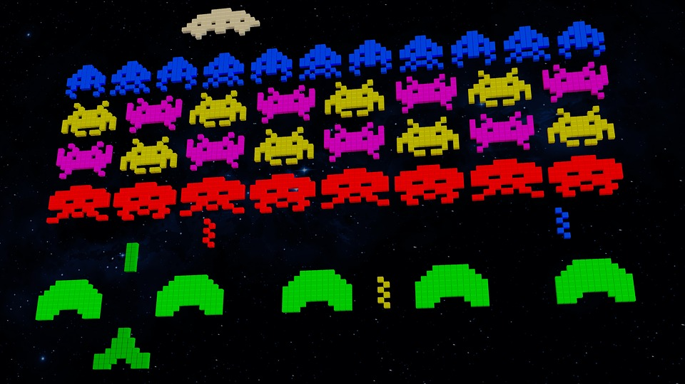
Truly random vs pseudorandom
Pseudorandom number generators
This uses mathematical algorithms which are computer-generated and therefore highly predictable.
Unless you are generating random numbers for security purposes, a pseudorandom generator would be fine, for instance in a computer game.
Notes:
Image source: https://pixabay.com/illustrations/background-video-game-80s-aliens-3311042/

Slide 42
Spot the difference
Question .
Identify the two differences between the two snippets of code below:
1
2
3
4
import random
number = random.randint(1,5)
print(number)
1
2
3
4
from random import choice
number = randint(1,5)
print(number)
The two lines highlighted indicate the different ways in which import can be used with modules/functions.

Slide 43

import module vs from module import
The code below imports the whole module and references the module AND the function when you want to use it.
The code below imports the specific function from a module and references them directly in the code.
1
2
3
4
import random
number = random.randint(1,5)
print(number)
1
2
3
4
from random import choice
number = randint(1,5)
print(number)
Using this method allows you to only import what you need.

Slide 44

Check out the comments
Commenting code is really important. It allows you to explain what your code does to someone who may read it if you are not there to explain it, and also to yourself in the future as an aid.
1
2
3
4
5
6
7
8
9
‘’’If you want a comment to span multiple lines, then use a triple quote at the start and end like this.’’’
print(“Comments are useful!”)
#Comments on a single line
#start with a hash symbol

Slide 45
Comment your code
Add suitable comments to your code to explain what your previous program did.
Be sure to use the most appropriate type of comment, either multi-line ’’’ ’’’ or single line #.
Comments generally start on the line above the line of code you are talking about.
1
2
3
4
5
from random import randint
my_number = randint(0, 10)
print(my_number)

Slide 46
Another function from random
This code imports a different function called randrange. Use the link below to access the code and complete the ‘Another function’ worksheet.
ncce.io/randrange
1
2
3
from random import randrange
my_number = randrange(0, 10, 2)
print(my_number)
Notes:
A5 Worksheet – Another function

Slide 47
The structure of randrange
The randrange function allows you to choose a minimum and maximum value, additionally the last parameter in the expression states the step value (what to count up in from the minimum).
1
2
3
from random import randrange
my_number = randrange(0, 10, 2)
print(my_number)

Slide 48
The structure of randrange
In this example, the step value 2 ensures the number output will always be even.
This could be changed to ‘count up’ in any number within the range stated.
1
2
3
from random import randrange
my_number = randrange(0, 10, 2)
print(my_number)

Slide 49
Changing the values
The minimum, maximum, and step values have been changed in this example.
Question .
How will the changes in values affect the output, and what would be a potential output of the program?
1
2
3
from random import randrange
number = randrange(20, 100, 7)
print(number)

Slide 50
Changing the values
Activity 5
The lowest output will be 20 and the highest output will be 100.
Anything in between these numbers will be in increments of 7.
Example
27, 41, 62 would be examples of valid outputs from the code.
1
2
3
from random import randrange
number = randrange(20, 100, 7)
print(number)

Slide 51
Learning Outcomes
Now you should be able to:
Data structures and their importance and showcase the data structures used in the demonstration program.
Basic algorithms that can be used in the software and the rationale for choosing certain algorithms over others.
Choice of platform based on different factors and the impact of evolving industry needs on platform and algorithm choices.

Slide 52

Questions?

Slide 53

Thank You!

